Slide 1

Talent Development Program
Module 3 : Data Warehouse
Session 7: Inmon & Kimball
Notes:
This template can be used as a starter file for presenting training materials in a group setting.
Sections
Right-click on a slide to add sections. Sections can help to organize your slides or facilitate collaboration between multiple authors.
Notes
Use the Notes section for delivery notes or to provide additional details for the audience. View these notes in Presentation View during your presentation.
Keep in mind the font size (important for accessibility, visibility, videotaping, and online production)
Coordinated colors
Pay particular attention to the graphs, charts, and text boxes.
Consider that attendees will print in black and white or grayscale. Run a test print to make sure your colors work when printed in pure black and white and grayscale.
Graphics, tables, and graphs
Keep it simple: If possible, use consistent, non-distracting styles and colors.
Label all graphs and tables.

Slide 2
Session Overview
1
2
Kimball Methodology
3
Star Schema & Snowflake
Inmon Methodology
Notes:
This is another option for an Overview slide.

Slide 3

Learning Objectives
Explain the Inmon Methodology used in data warehousing
Explain the Kimball Methodology used in data warehousing
Discuss the different levels of schemas in data warehousing
Notes:
What will the audience be able to do after this training is complete? Briefly describe each objective how the audience will benefit from this presentation.

Slide 4
Bill Inmon
Father of Data Warehousing
Takes the Top / Down approach to data warehouse design
More of an enterprise design with the use of data marts
More normalization
One central data warehouse with several smaller data marts for each department or company
Then each data mart can pull its own copy of data from the central data warehouse

Slide 5
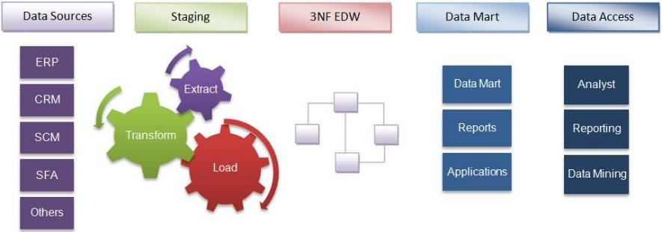
Inmon Methodology

Slide 6
Ralph Kimball
One of the Original Architects
Takes the Bottom / Up approach to data warehouse design
Setup more for each place or department to have its own data
More denormalized
Several separate data marts, each one with its own unique data for that department or company
All data marts can be networked together to make a whole data warehouse
More modern approach

Slide 7
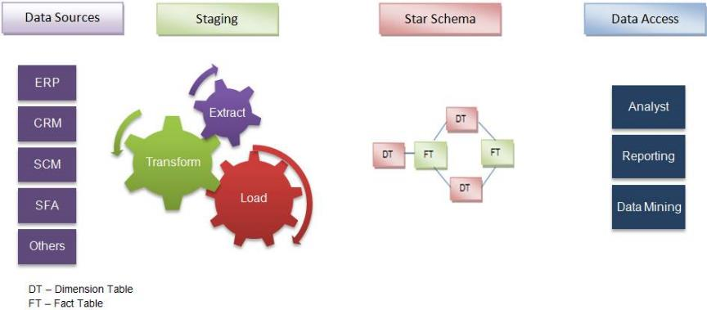
Kimball Methodology

Slide 8
Multidimensional Schemas in Data Warehousing
Star Schema
Information in dimensions are de-normalized
No subsets or Parent/Child dimensions
Snowflake Schema
Some dimensions are normalized, resulting in subsets or Parent/Child dimensions
Fast Constellation /Galaxy Schema
Normalization in both the dimensions used and facts used for finding information
Results in more dimensions and facts to be accessed

Slide 9
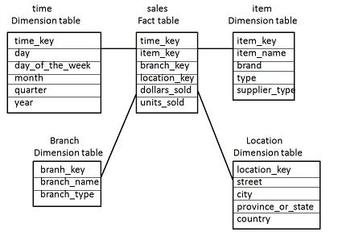
Star Schema

Slide 10
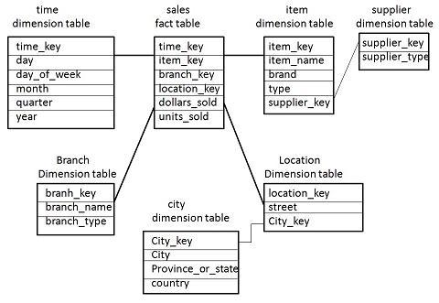
Snowflake Schema

Slide 11
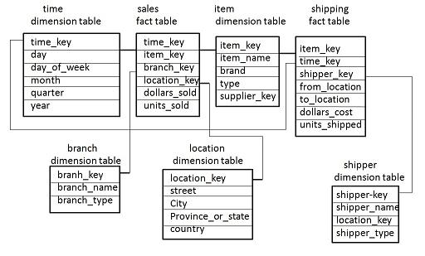
Fast Constellation Schema

Slide 12
Questions?
Notes:
Is your presentation as crisp as possible? Consider moving extra content to the appendix.
Use appendix slides to store content that you might want to refer to during the Question slide or that may be useful for attendees to investigate deeper in the future.

Slide 13

Summary
Explain what the Inmon Methodology is and how it works
Explain what the Kimball Methodology is and how it works
Discuss the different types of Schemas in a data warehouse
Notes:
Summarize presentation content by restating the important points from the lessons.
What do you want the audience to remember when they leave your presentation?
Save your presentation to a video for easy distribution (To create a video, click the File tab, and then click Share. Under File Types, click Create a Video.)

Slide 14
Thank You
Notes:
Is your presentation as crisp as possible? Consider moving extra content to the appendix.
Use appendix slides to store content that you might want to refer to during the Question slide or that may be useful for attendees to investigate deeper in the future.

